Slide 1


My Portfolio
Home
Ragavi
BCA Student
I'm passionate about coding, web design, and learning new technologies.
202X/X/X

Slide 2

ABOUT ME
I am Ragavi, a first-year BCA student with a strong passion for technology and creativity.
I enjoy learning programming languages such as C, C++, Java, and Python. I love solving problems and building projects that challenge my logical thinking and creativity.
I also like designing websites using HTML, CSS, and JavaScript. My dream is to become a professional software developer.
Outside of academics, I enjoy listening to music and spending time with friends

Slide 3
1
C, C++, Java, Python (Basics)
TECHNICAL
PROFICIENCY
2
HTML, CSS, JavaScript
3
Tools: Git, VS Code
4
OOPS, DBMS basics

Slide 4



Technical Summary
Interest in Programming and Algorithms.Passionate about solving problems using programming and algorithms, with hands-on experience in mini projects using HTML, CSS, and JavaScript. Possess basic knowledge of Python and Java, along with an understanding of DBMS concepts and Git fundamentals.
Creative Projects
Continuous Learning
Enjoy making unique and innovative projects that combine creativity and logic, helping you explore new ideas and develop your skills.
Eager to explore new technologies, gain knowledge, and improve skills every day through constant learning and growth.

Slide 5


Projects & Practical Experience
I have completed several mini projects including personal portfolio websites, simple web apps, and basic console applications. Each project has improved my coding and problem-solving skills.

Slide 6


EDUCATION
SSLC (2021)
Government Girls Higher Secondary School
Percentage: 71.4%
Bachelor of Computer Applications (2025‑Present)
SRM Arts and Science College
Currently pursuing (2nd year)
HSC (2023)
Government Girls Higher Secondary School
Percentage: 70.16%

Slide 7



Core Competencies
Creative Projects
Continuous Learning
Programming
Enjoy making unique projects with creativity and logic.
Eager to explore new technologies and improve skills daily.
Learning C, C++, Java, Python and Web Development.

Slide 8




My Tech Journey
Professional Growth Path
Continuous Learning
Creative Projects
Technical Knowledge
Learning C, C++, Java, Python, and Web Development to build strong coding skills.
Eager to explore new technologies and improve my skills every day.
Worked on mini projects using HTML, CSS, and JavaScript to enhance practical knowledge.
Basic understanding of Python, Java, DBMS, and Git fundamentals.

Slide 9
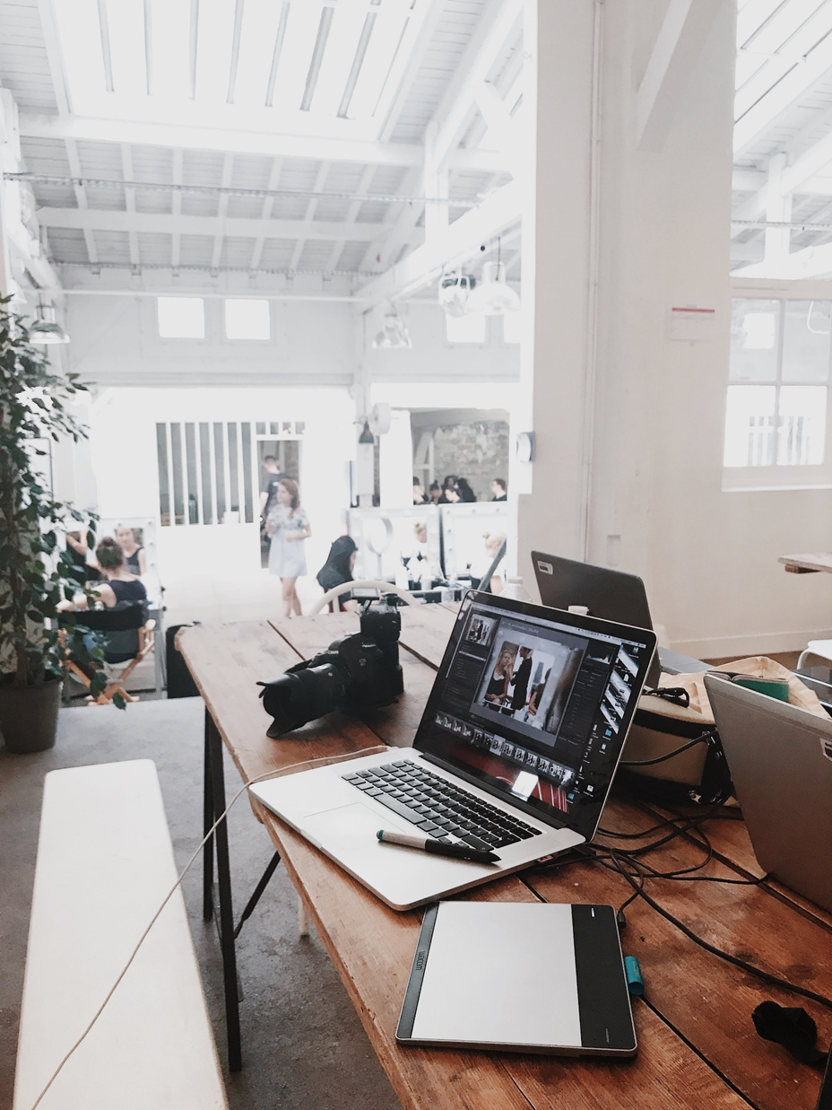
Performance Display
Showcasing my skills, projects, and achievements through practical implementations. Passionate about building innovative solutions, improving performance, and continuously enhancing my technical abilities.
View My Work

Slide 10

Summarize Experience
Gained practical knowledge through hands-on projects, exploring programming, web development, and database concepts. Continuously improving problem-solving skills and adapting to new technologies.
View Details

Slide 11
GITHUB LINK
https://ragavr-bca.github.io/nm/

Slide 12
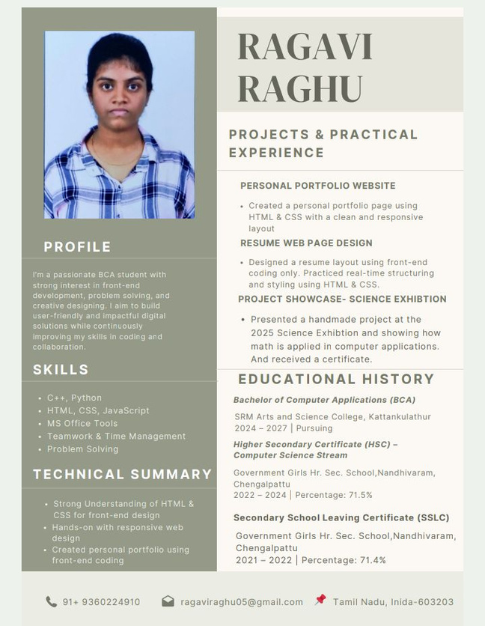
MY RESUME

Slide 13
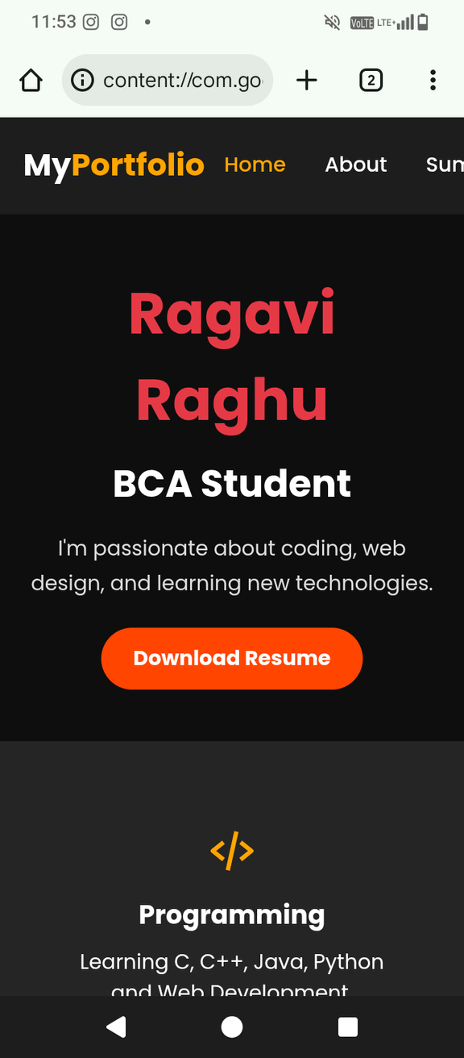
PORTFOLIO

Slide 14

WORK PLAN IN FUTURE
Aiming to build a successful career in the IT industry, focusing on web development, programming, and problem-solving. Dedicated to improving my skills, gaining hands-on experience, and working on innovative projects to achieve my career goals.
My Future Goals
CONTACT
Email: ragaviraghu05@gmail.com
Phone: +91 9360224910
LinkedIn: linkedin.com/in/yourprofile

